Slide 1

Heart Disease Prediction Model Using Decision -Tree Classifier and Information Theory Approach
Presented By -:
Kunal Mangaonkar
Al-Mothana Maghaydah
Bhagyashree Narkhede

Slide 2

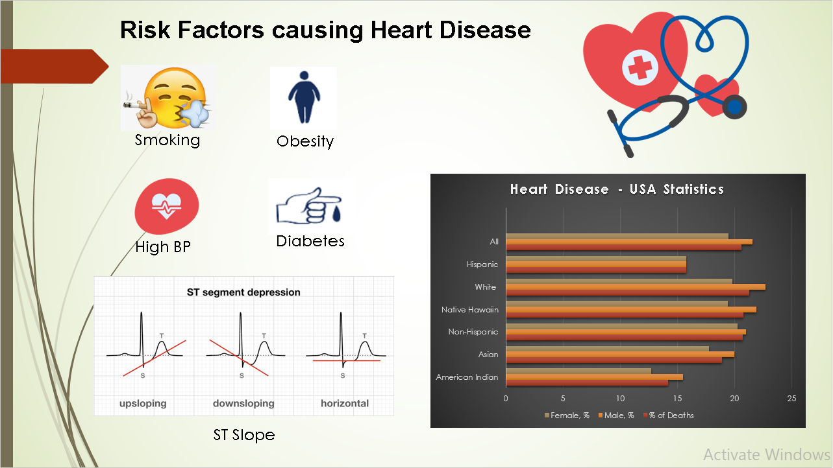
Background. Why it is Imp ?
Heart disease Life-threatening disease.
In most situations, the diagnosis of cardiac disease is based on a complicated mix of clinical and pathological data.
High medical expenses,
Diagnosis Signs and Symptoms
Cardiovascular diseases (CVDs) are the leading cause of death globally.
An estimated 17.9 million people died from CVDs in 2019, representing 32% of all global deaths. Of these deaths, 85% were due to heart attack and stroke.
Out of the 17 million premature deaths (under the age of 70) due to non-communicable diseases in 2019, 38% were caused by CVDs.
It is important to detect cardiovascular disease as early as possible so that management with counselling and medicines can begin.

Slide 3





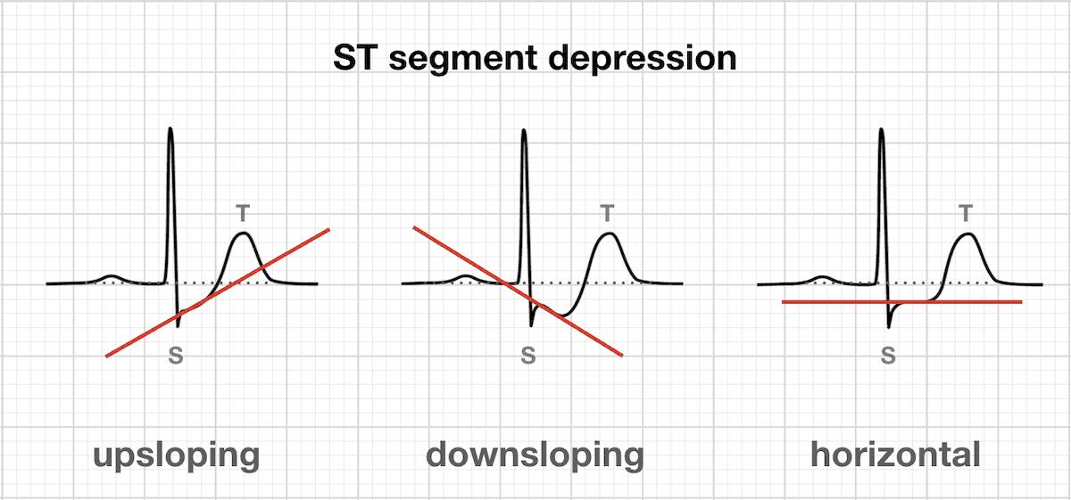
Risk Factors causing Heart Disease
Smoking
Obesity
High BP
Diabetes
ST Slope

Slide 4
Problem Statement -
The past literature reviews don’t speak greatly about heart failure attributes and causes or go through a deep analysis to know the most vital feature effect this phenomenon, so what we are focusing on in our report and project is to define the most important feature and their related relation when they combined together and this will be done through the following:
Decision tree classifier using entropy and GINI index
Information theory (entropy and mutual information)
Dependency and multivariate effect using conditional probability.
In this study, we analyzed the various prescribed data from 920 patients from various regions. We analyze and predicted a model that uses this data to be trained and attempts to predict if additional out-of-sample data will have a likelihood of a heart attack occurring or not depending on the most important factors. This approach can aid in decision-making so that the patient is treated properly and that there is open communication between the doctor and the patient. The model must consider more than just accuracy when dealing with the validation set of the data.

Slide 5
Dataset - Info
The Dataset is non-linear which contains total of 918 rows and total of 12 columns with 1 Target Variable and 11 Features columns
Age – ( Age of the Patient)
Sex – ( Is it Male or Female ?)
Chest Pain Type – (When a portion of your heart does not receive enough oxygen-rich blood, angina develops. Cause: narrowed coronary arteries.) Four Types ( TA, ATA, NAP, ASY)
Cholesterol – ((Normal: less than 200 mg/dL , Medium: 200 to 239 mg/dL ; High: 240 mg/dL or greater)
Fasting Blood Sugar
Resting ECG - Electrocardiogram captured when person is in resting state (Normal, LVH, ST)
Max Heart Rate
Exercise Angina – (Portion of heart not receiving oxygen rich blood due to exercise is exercise angina.)
Old peak value - Measuring the value of ST in depression
ST Slope - The change in the ST segment in relation to heart rate increases brought on by exercise (flat, up and down used in dataset).
Target Variable :- Heart Disease – (Y/N)

Slide 6
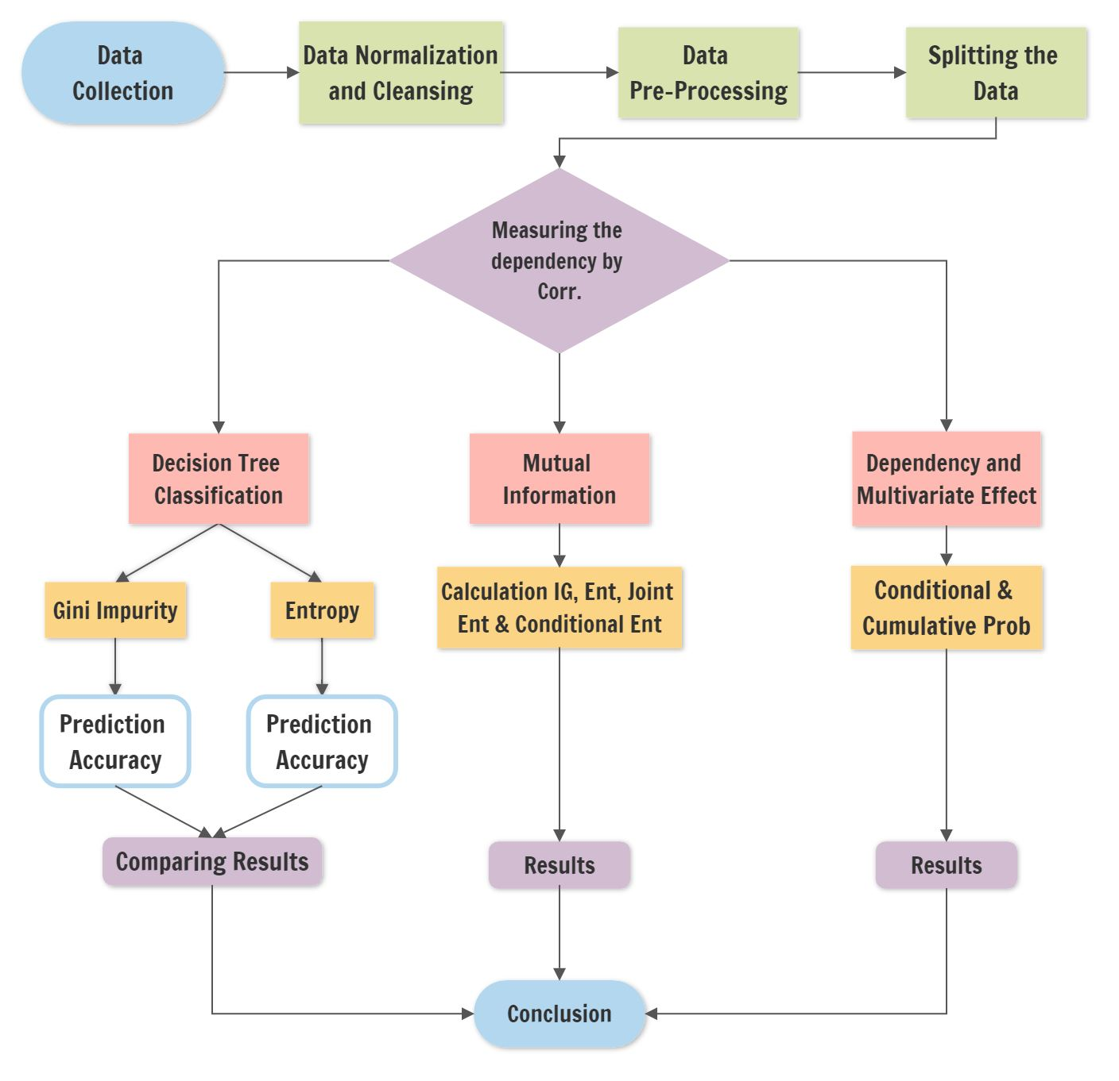
Methodology

Slide 7
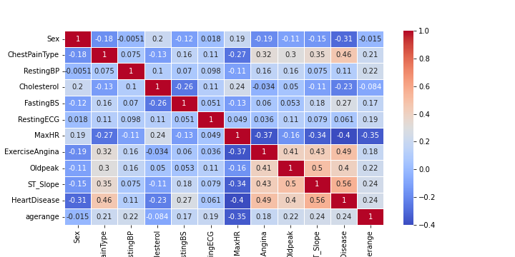
Why Mutual Information Approach ?
As the Dataset non-linear correlation when the Pearson correlation falls short.
Used for –
Feature selection for predicting factors affecting Heart Failure
Making splits in tree-based models based on Information Gain

Slide 8
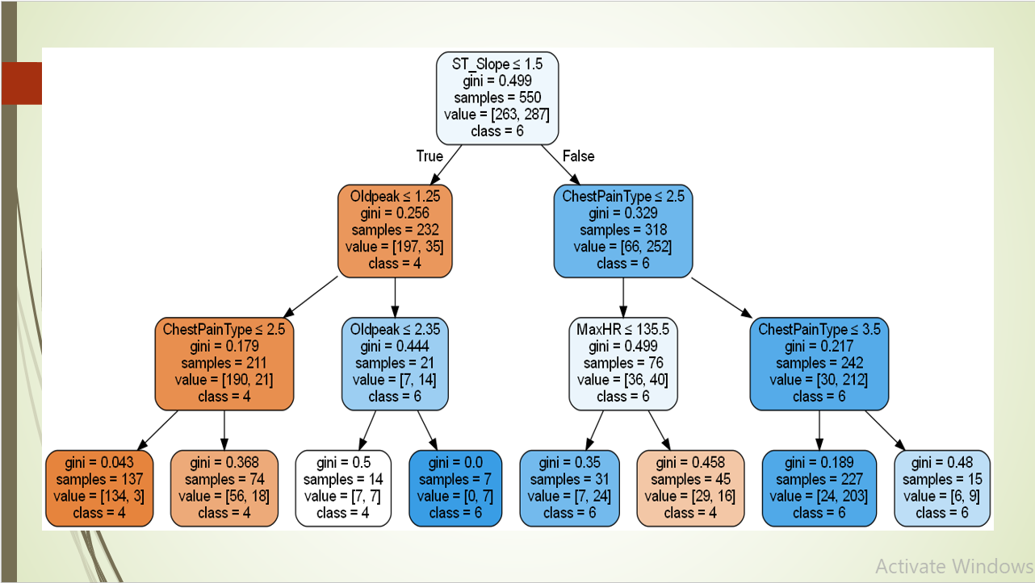
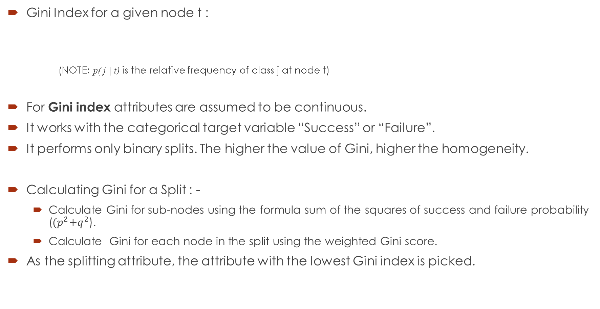
Decision Tree Classifier – Gini’s Impurity
Gini Index for a given node t :
(NOTE: p( j | t) is the relative frequency of class j at node t)
For Gini index attributes are assumed to be continuous.
It works with the categorical target variable “Success” or “Failure”.
It performs only binary splits. The higher the value of Gini, higher the homogeneity.
Calculating Gini for a Split : -
Calculate Gini for sub-nodes using the formula sum of the squares of success and failure probability (${(p}^{2}+q^{2}$).
Calculate Gini for each node in the split using the weighted Gini score.
As the splitting attribute, the attribute with the lowest Gini index is picked.

Slide 9
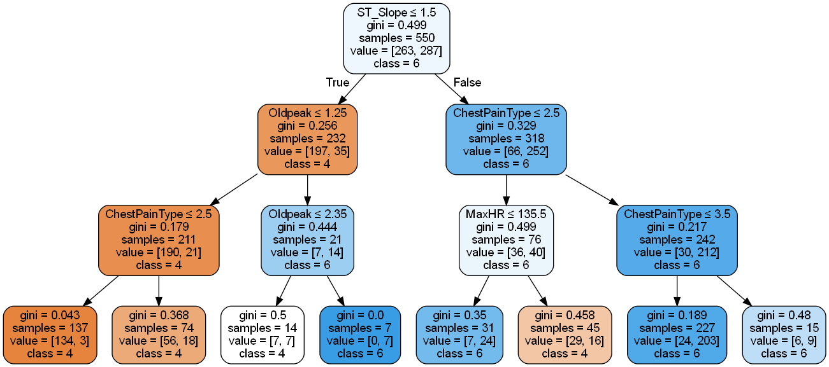

Slide 10
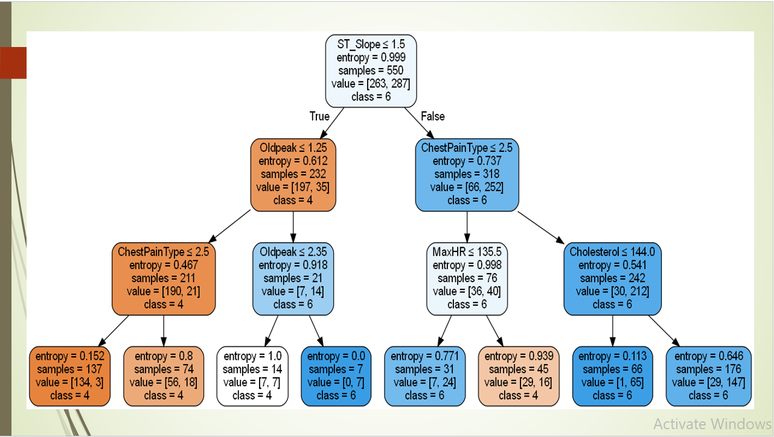
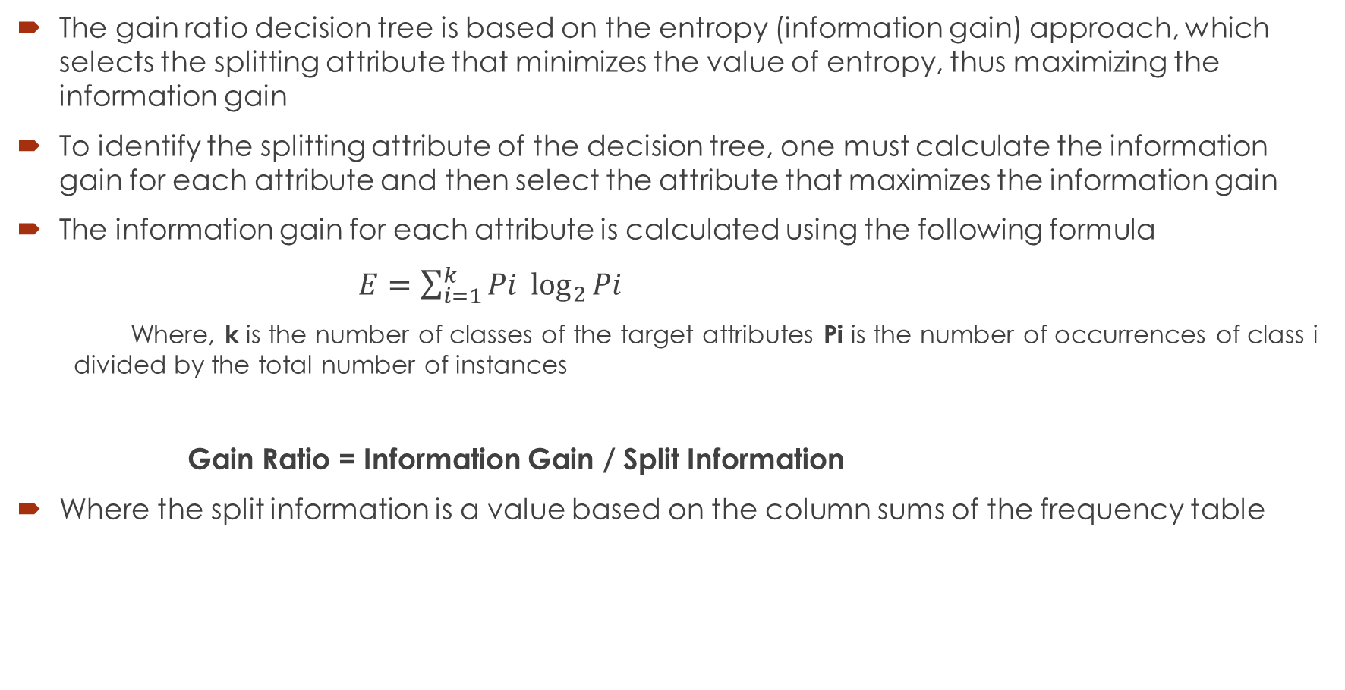
Decision Tree Classifier – Entropy
The gain ratio decision tree is based on the entropy (information gain) approach, which selects the splitting attribute that minimizes the value of entropy, thus maximizing the information gain
To identify the splitting attribute of the decision tree, one must calculate the information gain for each attribute and then select the attribute that maximizes the information gain
The information gain for each attribute is calculated using the following formula
$E=\sum_{i=1}^{k}{Pi \log_{2}{Pi}}$
Where, k is the number of classes of the target attributes Pi is the number of occurrences of class i divided by the total number of instances
Gain Ratio = Information Gain / Split Information
Where the split information is a value based on the column sums of the frequency table

Slide 11
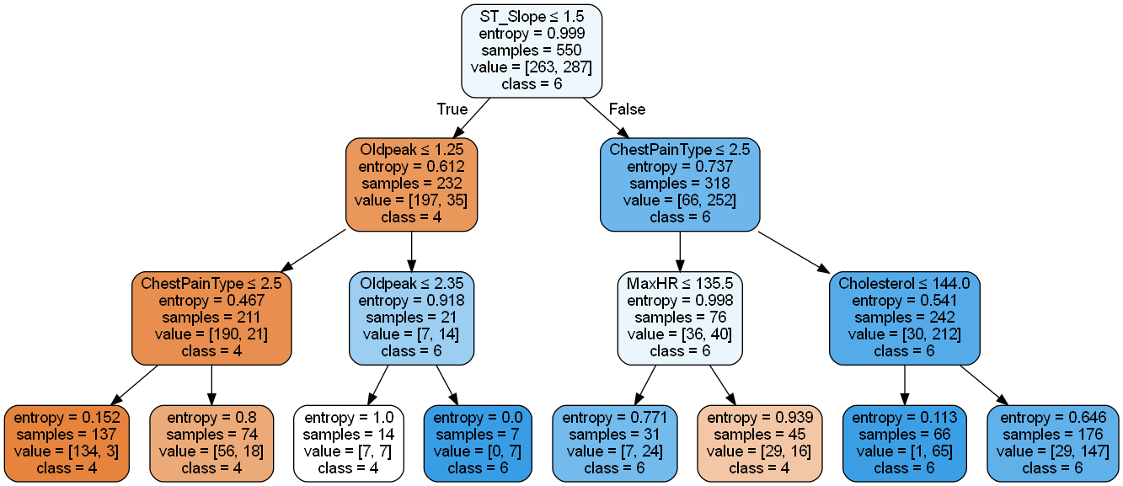

Slide 12
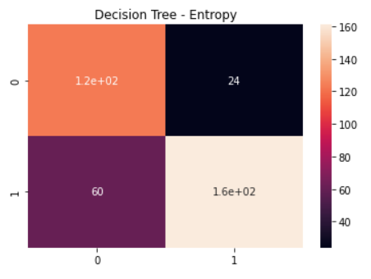
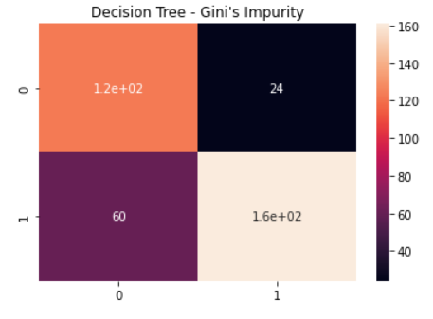
Conclusions -
The most important feature is ST-slope as the threshold value is 1.5 and then the branches start to come.
So, what we need to say there is are three attributes at least must be known to decide if there is heart failure or not. And the most important are ST slope, heart rate, Chest Pain Type, and old peak.
Factors | Gini index | Entropy
Model accuracy | 0.7717 | 0.8777
f1-score | 0.79 | 0.80
Precision | 0.83 | 0.87

Slide 13
Mutual Information
What is Mutual Information ?
Joint entropy
Entropy of product probability space XY:
H(XY) = - ∑ x ∑ y p(x, y) log p(x, y)
Conditional entropy
Expected (remaining) entropy of Y after an observation of X:
H(Y | X) = - Σx Σy p(y, x) log p(y | x)
Mutual information
Expected reduction of uncertainty in Y after an observation of X
I(Y;X) = H(Y) – H(Y | X)

Slide 14
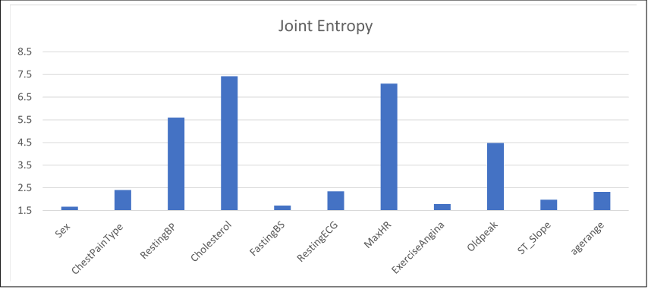
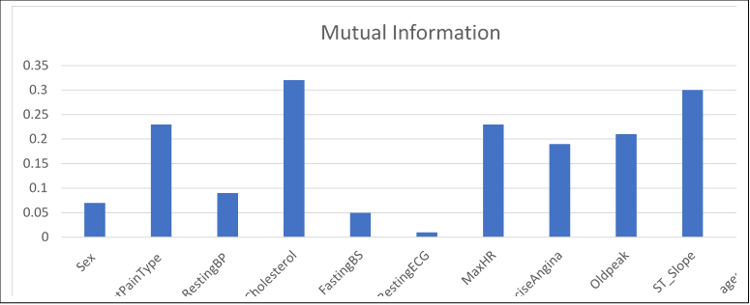
Conclusions :
After Calculating all the above parameters, below are the graphs shows the distribution of each feature and the result:
`
The M.I. which means the expected reduction in uncertainty regarding the decision tree the information theory gives the same results as the higher M.I. the higher information gained so again ST-Slope, old peak, heart rate, chest pain type the higher information theory which affects the result to any observation to suffer from heart failure.

Slide 15
Dependency and multivariate effect
We calculate the conditional probability for each attribute giver that a heart failure dedicated.
P (A/ Heart failure =1) = P (A Ո Heart failure =1) / P (Heart failure =1)
We can discover that if you have 100 observations around 32 of them will suffer from heart failure if the ST slope isn’t in the normal range.
An additional 10% also suffered from chest pain having 42 observations out of 100.
Old peak shows affect 5.76% of observations and heart rate 1.06%.
So the most two factors that shouldn’t be affected by the ST-Slope and Chest Pain Type because you have a probability of 75.24% for heart failure.

Slide 16
Summary
As we mentioned in the conditional probability the joint entropy follows the same probabilities with the same attributes.
The difference in all decisions is that the cholesterol factor appears to form the perspective of the information theory to be considered while assigning new observations

